Slide 1
ESRM 433 / SEFS 533 LAB 2
Intro to Coordinate Refence Systems (CRS)
Lidar Metadata
Introduction to LidR and RStudio
Accessing online help and documentations for LidR and RStudio

Slide 2

How do we know where on Earth we are?
Use latitude and longitude?

Slide 3
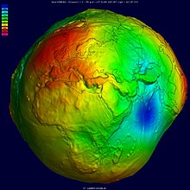
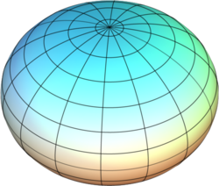
Is the Earth round?
No! – Well, kind of…
The Geoid Earth
This makes determining locations with coordinates difficult
We can approximate using an ellipsoid
Check out the field of geodesy https://en.wikipedia.org/wiki/Geodesy

Slide 4
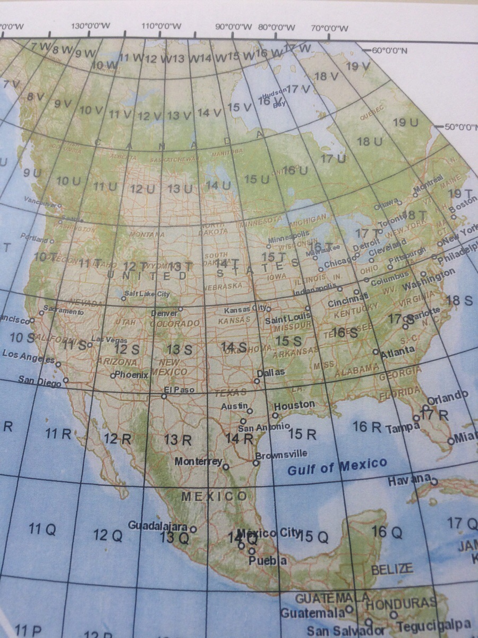
Coordinate Reference Systems (CRSs)
Geographic vs Projected
https://www.youtube.com/watch?v=xJyJlKbZFlc

Slide 5
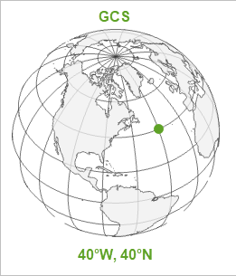
Geographic Coordinate System
Where to put your latitude and longitude lines or the model ellipsoid
Datum
The reference point
Most common in North America
NAD27, NAD83, WGS 84

Slide 6

Projected Coordinate System
How to draw a flat map in the location of the GCS

Slide 7
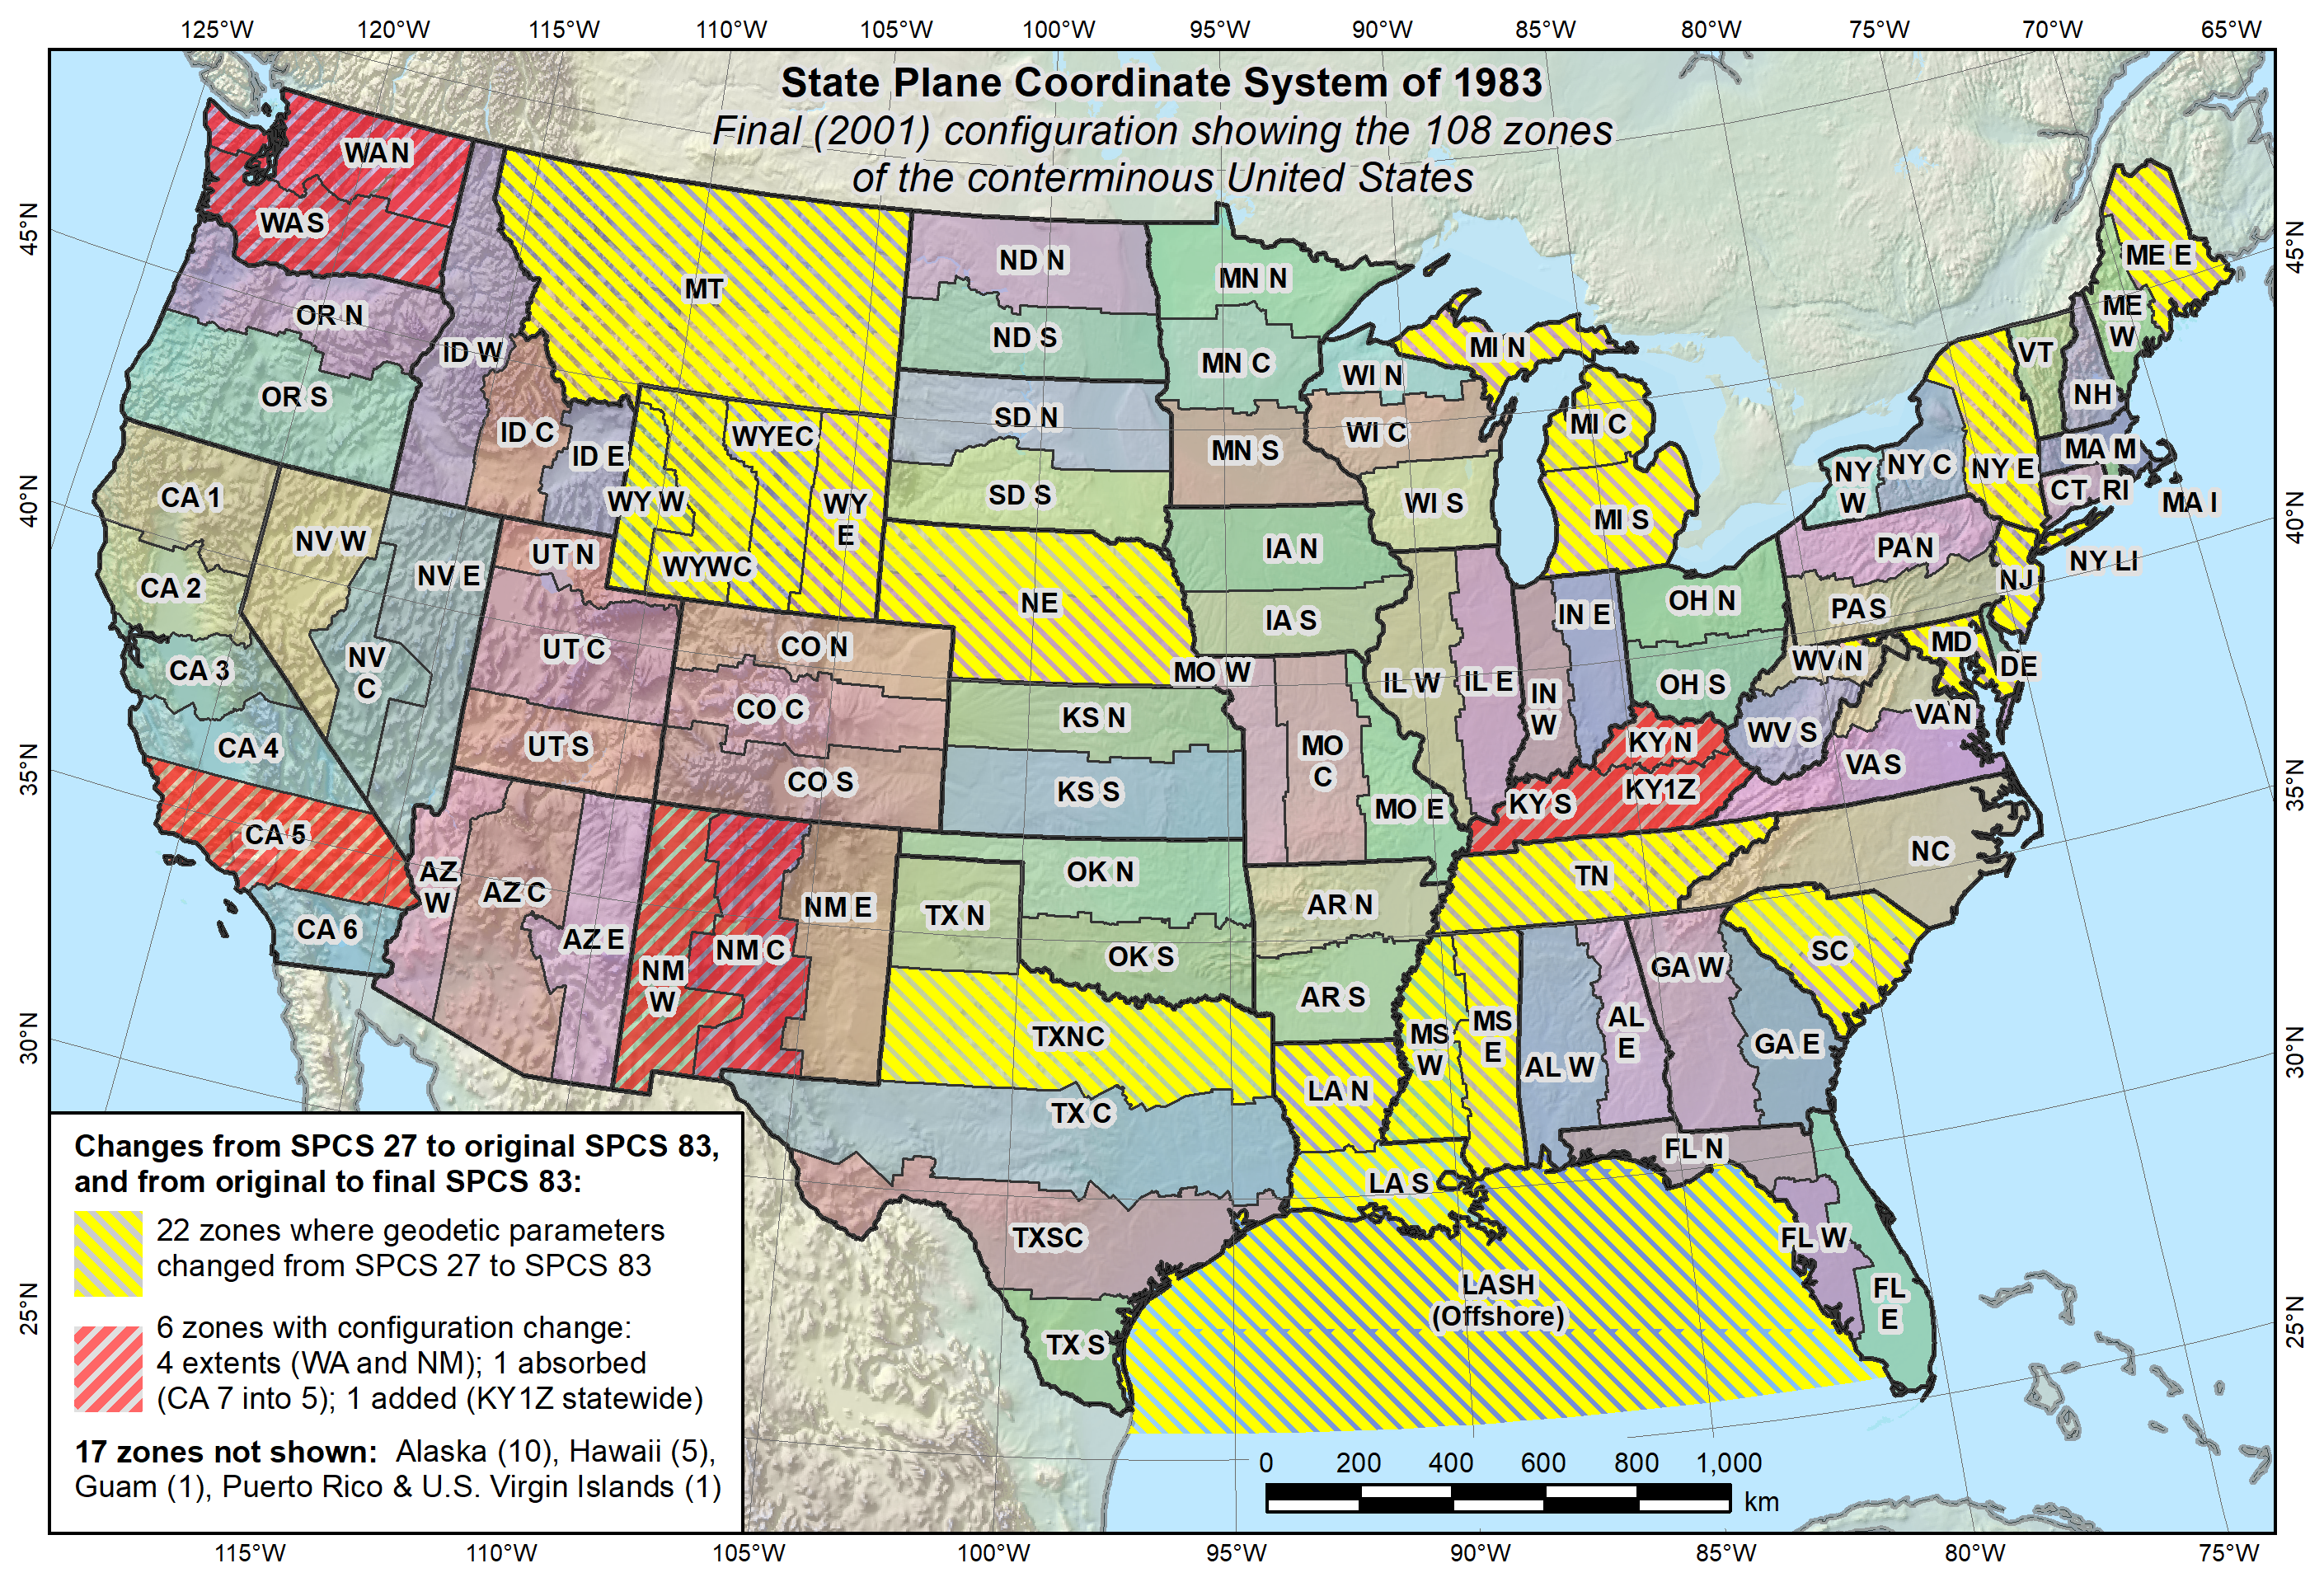

Slide 8
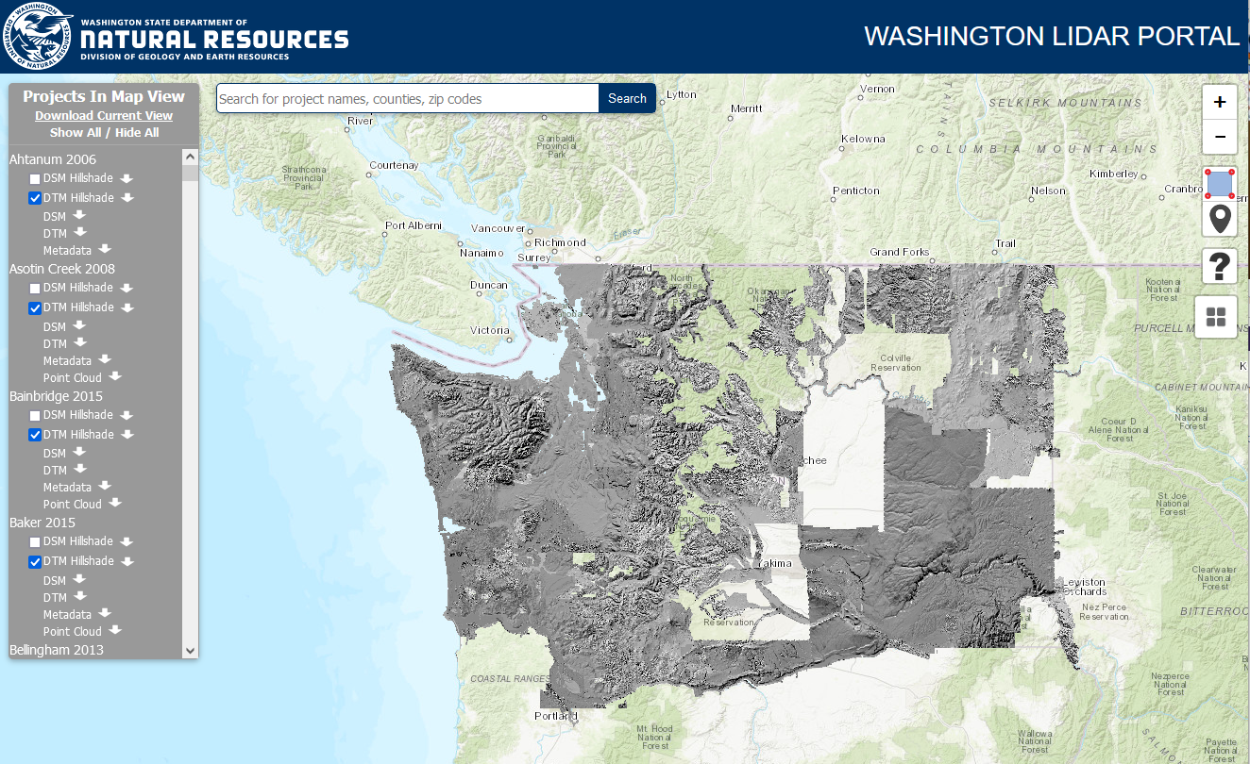
Back to the DNR
Default: Washington State Plane South
Downloadable from DNR
Digital Surface Model (DSM) Hillshade
Digital Terrain Model (DTM) Hillshade
DSM
DTM
Metadata
Point Cloud

Slide 9
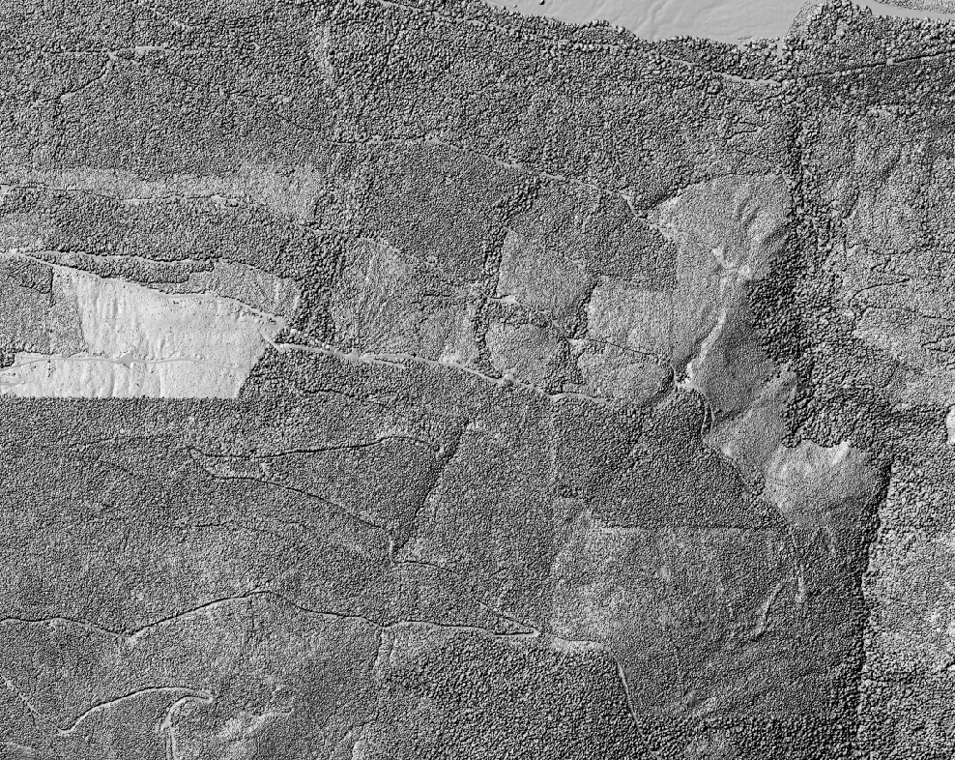
Digital Surface Model Hillshade
First Returns
95th Percentile
A “Blanket”
Hillshade adds a light direction to give definition to the points

Slide 10
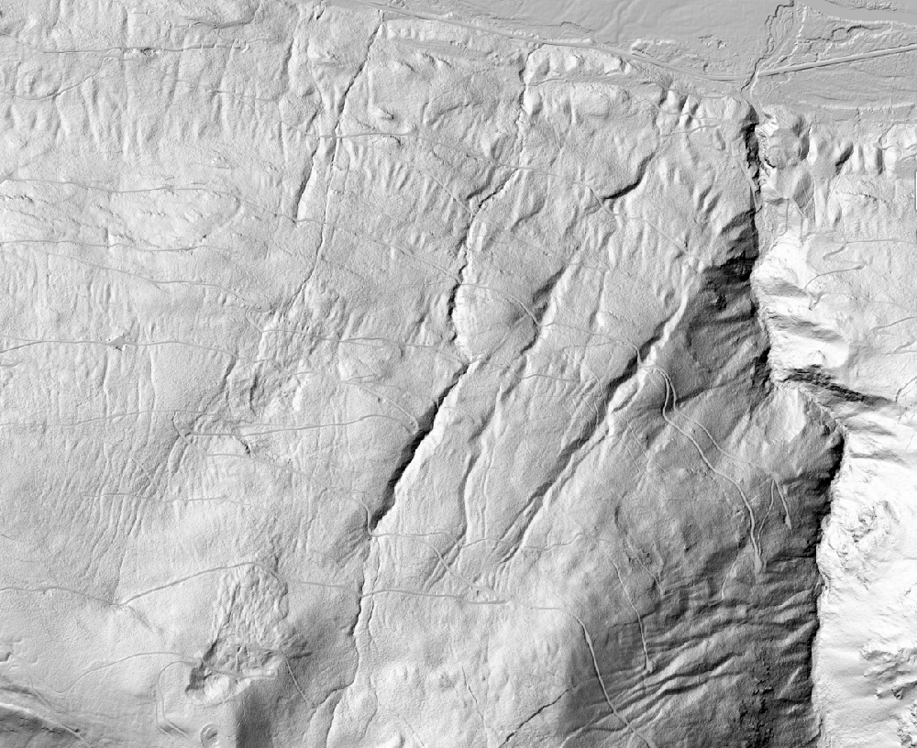
Digital Terrain Model Hillshade
Ground Returns
Lowest lidar returns
Trees and buildings are removed
Hillshade adds a light direction to give definition to the points

Slide 11
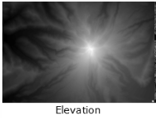
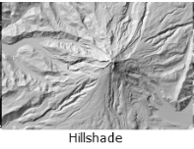
DTM vs DTM hillshade more on this next lab…

Slide 12
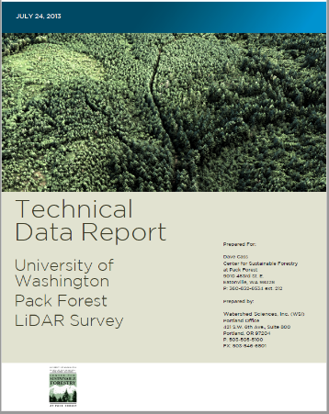
Metadata
Produced by the acquisition company
Technical aspects
Date
Location and Area
Lidar scanner used and point density
Ground control
Projection information
More…

Slide 13
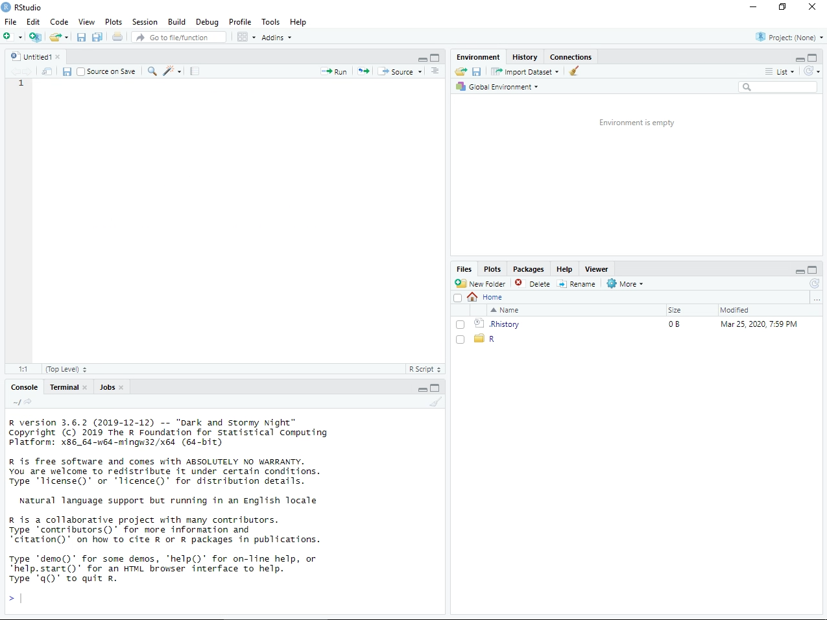
RStudio and lidR
You are not expected to be fluent in R for this class
lidR is a package for R that is built to deal with lidar data
Basic R tutorial you can run trough to get more comfortable
https://education.rstudio.com/learn/beginner/

Slide 14

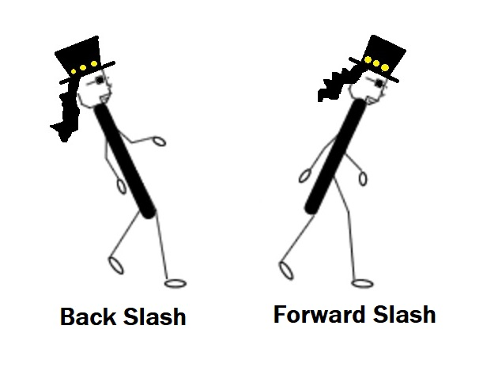
R code common issues
Forward Slash / vs Back Slash \
No spaces!
Quotation marks “”
Capitalization MaTtERs!
Ctrl + Enter to run a line of code
One wrong character will prevent your code from running!

Slide 15

For the rest we will head to RStudio

